Slide 1

GAAP Feasibility Analysis Report
Group 05
Weike Zhou, Peijia Wu, Chengshu Yang, Leqi Yin, Yu Luo

Slide 2
Schema
Background
Precision Agriculture and GAAP
Location
Selection Process
Why Australia?
Recommendation
Market
Marketing & Other (Promotion）
Price Point
Shipping Costs
Fixed Costs

Slide 3
Background
Precision Agriculture and GAAP

Slide 4
Background-Precision Agriculture and GAAP
Acquisition
New technology - Precision Agriculture
GAAP - Gyrfalcon Agricultural Analytics Platform
Sensor + communication interface + software
Overseas market - outside the U.S and Canada
Minor business → just for 3-5 years, act quickly
Where?
How?

Slide 5
Location
Selection Process
Advantages of target country

Slide 6
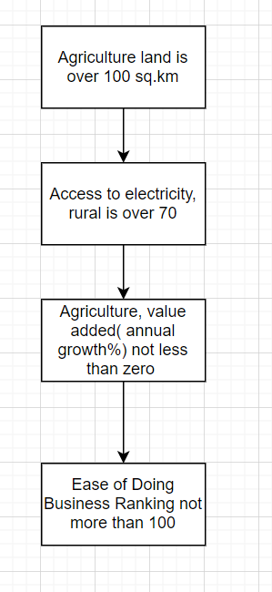
Location - Selection Process
Narrow down to:
China
Australia
Kazakhstan
Saudi Arabia
Mexico
Colombia
Thailand
United Kingdom
Germany
Chile
Australia
(check appendix 1 for selection results)

Slide 7
Location
Selection Process
Advantages of target country

Slide 8
Location - Australia!Why?
Advantage:
Geographically competition
Easy of doing business
Supportive Infrastructure
Advantage of GAAP to competitors

Slide 9
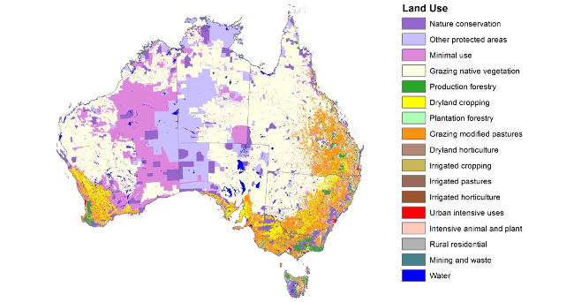
Advantage 1：Geographically competition
Large agriculture Area
3966.153 square kilometers
52% of total land area
Weather
Suitable for crop to grow
Midland of west annual rainfall 370~600mm
Type of crop
Safflower, Wheat , Sorghum
Cotton ,Oats, Barely, Canola
Notes:
Impact of a vegan agricultural system on land use,, https://www.veganaustralia.org.au/impact_of_a_vegan_agricultural_system_on_land_use
Niche and specialty crops are becoming more prevalent as croppers seeks to diversify,
https://www.farmonline.com.au/story/5048348/seven-crops-probably-not-in-your-rotation/
International Student - Map and Climate,
https://www.internationalstudent.com/study_australia/living_in_australia/map-climate/
Crop and climate suitability for irrigated agriculture in the Midlands area of Western Australia,
https://www.agric.wa.gov.au/sites/gateway/files/Crop%20and%20climate%20suitability%20for%20the%20Midlands%20area%20of%20Western%20Australia%20-%20RMTR%20405%20%28PDF%204.6MB%29.pdf

Slide 10
Advantage 2.1:
Easy for us to do business
Easy to enter → less restriction
Country - wise
Company - wise

Slide 11


Advantage 2.1 - Easy to enter Australia Market
Country-wise
Company-wise
Free Trade Agreement with U.S
Tariff Cuts
Freight and Logistic
Detail guidelines
Drone Registration
Licence for remote pilot
Operator accreditation instead for some cases
Drone Policy
Notes:
Drone Rules, https://www.casa.gov.au/knowyourdrone/drone-rules
SUMMARY OF SMALL UNMANNED AIRCRAFT RULE (PART 107), https://www.faa.gov/uas/media/Part_107_Summary.pdf
Australia-United States FTA,
https://www.dfat.gov.au/trade/agreements/in-force/ausfta/Pages/australia-united-states-fta

Slide 12
Advantage 2.1 (continued)
Drone Policies and Regulations -
Highly Similar!
 | US | Australia
Maximum Altitude | 400 ft AGL | 120m(400ft) AGL
Minimum Visibility | 3 miles | 5km (about 3.11 miles)
Maximum weight | 55lbs (25 kg) | No specific limitation. Classify drones by its weight.
=
=
<
Notes:
Australia-United States FTA,
https://www.dfat.gov.au/trade/agreements/in-force/ausfta/Pages/australia-united-states-fta

Slide 13
Advantage 2.2:
Easy for us to do business
Need for precision agriculture technology in Australia
Efficient and affordable
Suitable for local crops
Notes:
https://www.agriculture.purdue.edu/SSMC/newsletters/March03_GlimpseofPrecisionAgricultureAustralia_gregedit1.htm#:~:text=The%20most%20surprising%20aspect%20of,the%20ends%20of%20the%20field.
https://www.sciencedirect.com/science/article/abs/pii/S037842900700113X
https://www.researchgate.net/publication/262706376_Precision_agriculture_in_Australia_present_status_and_recent_developments

Slide 14
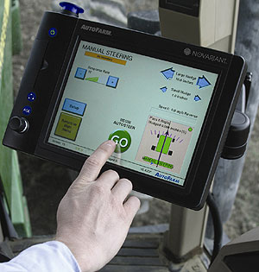
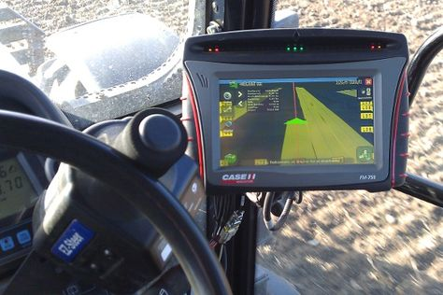
Autosteer and Controlled Traffic
Controlled traffic limits farm equipment to specific paths through the field.
Autosteer allows growers to follow the same paths
Advantage 2.2
Single-function technology
High accuracy but low efficiency

Slide 15
Yield Maps Create management zones
Australia has developed a method for using yield maps, remote sensing, soil types and other data to help choose those areas to plant different crops.
Different crops require different oxygen and nitrogen content.
Soil depth is highly correlated with yields and nitrogen requirements.
Advantage 2.2
Need a time-saving and labor-saving detection tool.
Suitable for wide detection area

Slide 16
When Considering :
Cost of adopting further precision agriculture tools.
Efficiency
A wide variety of crops Variable Rate Fertilizer
Zonal management
Challenge
GAAP

Slide 17
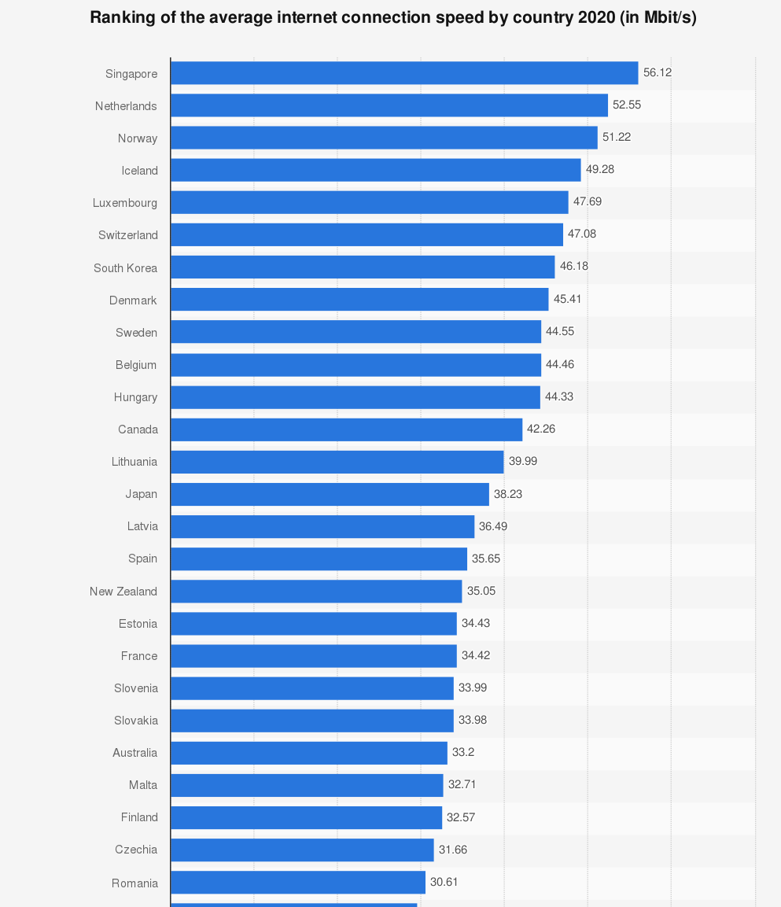
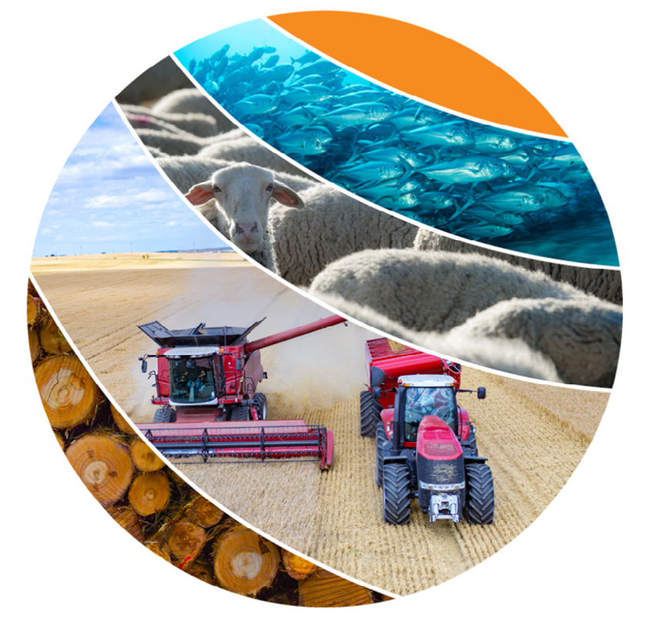
Advantage 3: Supportive Infrastructure Advantage
100% of access to electricity in rural Australia.
96 % of Australian farmers owned and used ICT assets, and 95 % were connected to the internet.
Rank 22nd in "The average internet connection speed by country 2020".
Nationwide Broadband Network
Notes:
https://www-statista-com.proxygw.wrlc.org/forecasts/1147038/internet-connection-speed-by-country
https://www.agriculture.gov.au/abares/research-topics/productivity/productivity-publications/ict-use-summary#download
https://minister.infrastructure.gov.au/fletcher/media-release/45-billion-nbn-investment-bring-ultra-fast-broadband-millions-families-and-businesses-and-create-25000-jobs

Slide 18
Highly developed technology
Competitive Price
Reliable customer service
Advantage 4: GAAP to competitors
Sensors and radio links are rugged
software sits safely at the base station
lightweight
Cheaper than military-grade technology which wide used in precise agriculture
Inexpensive replacement parts
Reliable technical support

Slide 19
Recommendation
Market
Marketing & Other (Promotion）
Price Point
Shipping Costs
Fixed Costs

Slide 20
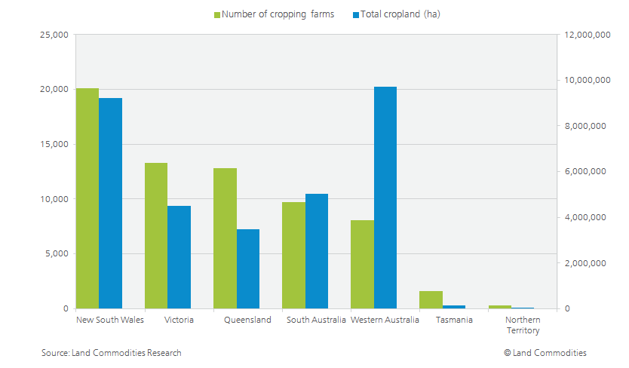
Recommendation - Market
Total cropland: 9.7 million hectares
National average for the annually cropped area per farm: around 800 hectares
It is estimated that less than 10% of farm businesses are involved in precision farming.
Notes:
http://www.consortiumland.com/investors/variations-in-farm-size-across-the-australian-wheatbelt/

Slide 21
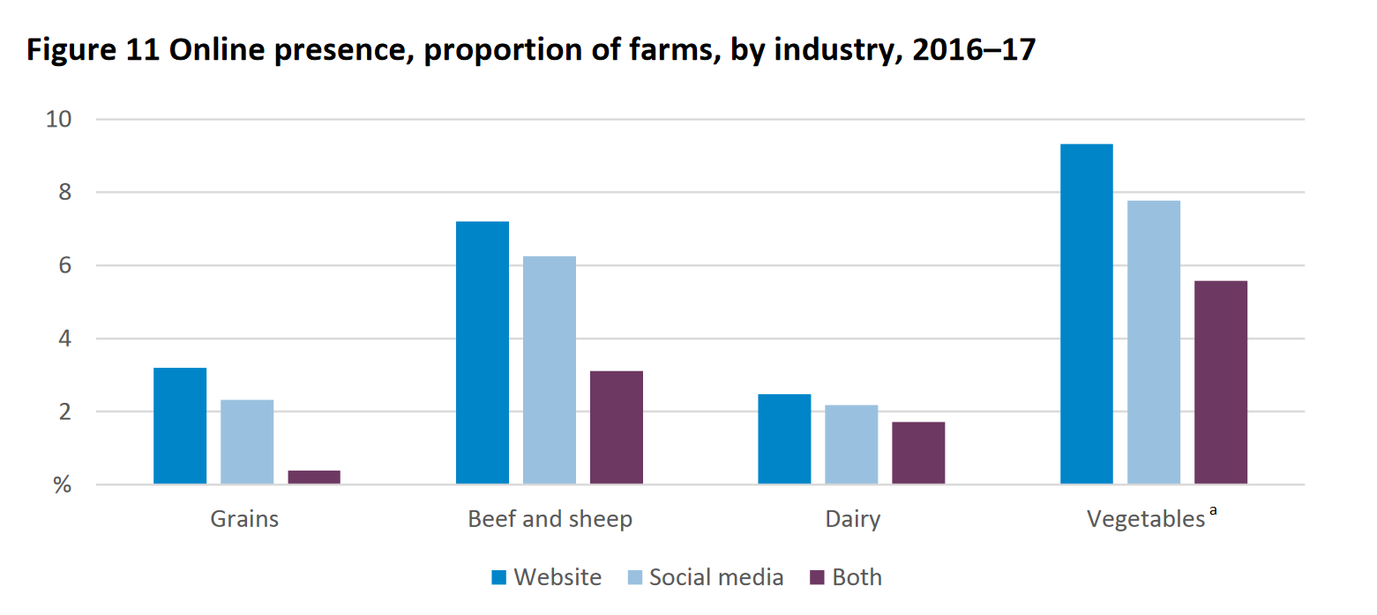

Recommendation - Promotion
Marketing in both traditional and digital:
Newspapers
TV
Radio
Social Media
Websites
Amazon
Google
Bing
Notes:
From last slide we can see the marke size of Australia is very large, so how we increase our sales in this market? Nowadays, Social media is commonly used by many people and companies to develop a company image, market products and communicate with customers (ABS 2017a). So digital marketing is a good way to promotion our products definitely. However, as you can see from the picture on the left side, it shows the proportion of farms online presence by industry that in some industry, relatively few farms reported having a web presence (6 per cent), or a social media presence (5 per cent) or both (2 per cent). So, we highly suggested to market in both traditional way by putting ads on newspapers, tv or radio and digital way advertising on facebook, twitter, and google search.
https://www.agriculture.gov.au/abares/research-topics/productivity/productivity-publications/ict-use-summary#download

Slide 22




Recommendation - Promotion
Estimated price for each methods:
Newspapers
TV ads:
Social Media
Website
$600 - $50,000/a full-page
$2000 - $3000 / 30s
$400 - $22,000/month
$5,000 - $15,000/month
Notes:
Here is the estimated price for each marketing platform. We could choose a best combination to maximize our promotion sales.
Newspaper: https://www.savvysme.com.au/article/6-how-to-measure-the-cost-of-print-advertising
TV: https://www.logicsofts.com.au/television-advertising-costs-australia.html/
Social Media: https://astonsocial.com.au/guide/how-much-does-social-media-marketing-cost
Webs: https://www.webapex.com.au/google-ads-cost

Slide 23
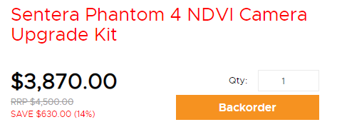
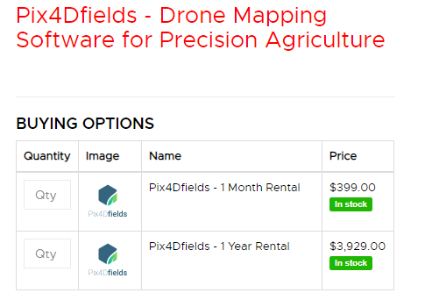
Recommendation - Price Point
Comparison with similar products in Australia
Sensor
<
$ 3000 AUD
Software for Analysis
$ 350/mo AUD (1-month)
$ 320/mo AUD (12-month)
(check appendix 1 for further comparisons)
($327/mo)
Notes:
Rise Above, Pix4Dfields - Drone Mapping Software for Precision Agriculture，, https://www.riseabove.com.au/pix4d-ag-drone-mapping-software-for-precision-agri
Rise Above, Sentera Phantom 4 Pro NDVI Camera Upgrade Kit https://www.riseabove.com.au/sentera-phantom-4-pro-ndvi-camera-upgrade

Slide 24
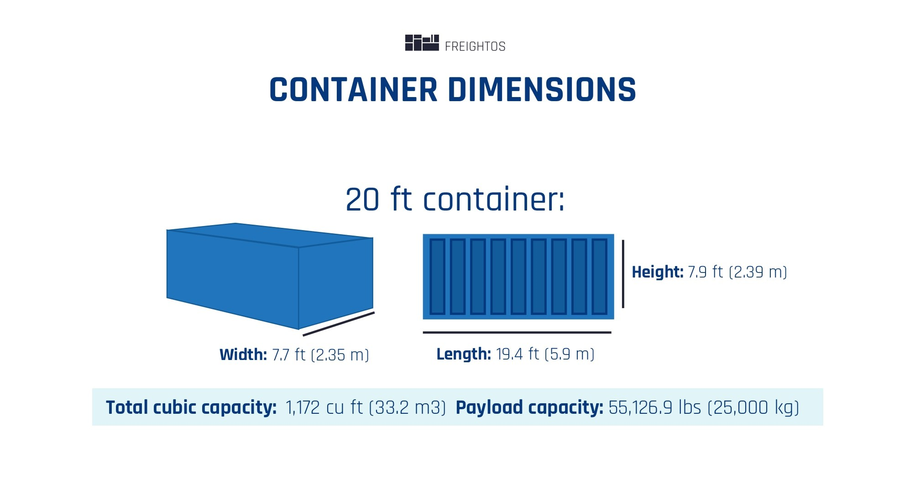
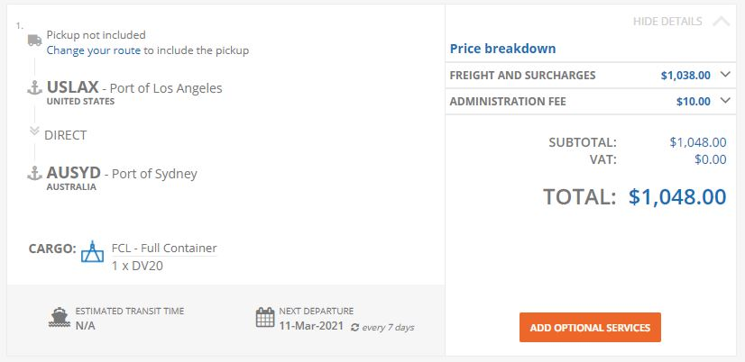
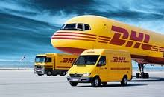


Recommendation - Shipping Costs
Estimate 6$/box
Shipping cost less than 4% of the price +10% GST (Goods and Services Tax)
Price are negotiable
Multi-optional logistic firms and shipping methods
Notes:
GST(Goods and Services Tax)
Quote result for FCL shipping cost:
https://www.icontainers.com/quotes/FCL/USLAX/PORT/US/AUSYD/PORT/AU/
Australian Border Force:
https://www.abf.gov.au/importing-exporting-and-manufacturing/importing/cost-of-importing-goods

Slide 25
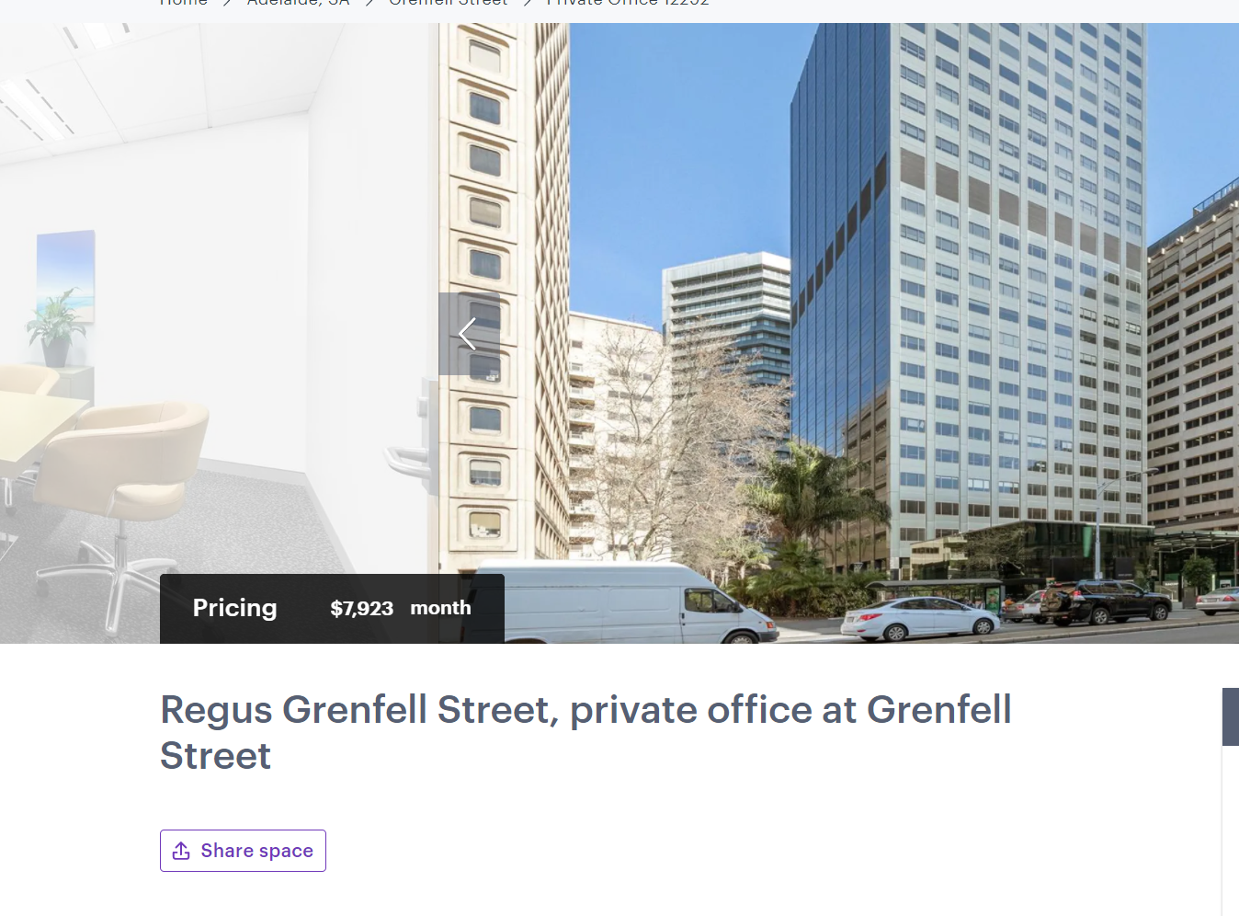
Recommendation - Fixed Price
Office( Adelaide,500sqm)
Annual cost of renting: 7923*12=95076
Notes:
Spacely, https://www.spacely.com.au/grenfell-street/private-office-space12292

Slide 26
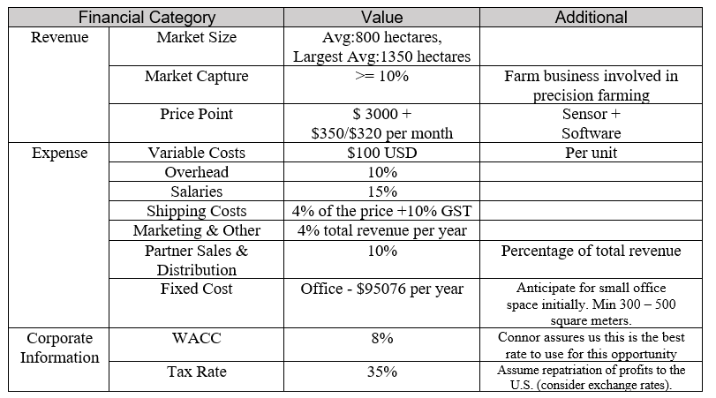
Recommendation Conclusion

Slide 27
Q & A

Slide 28

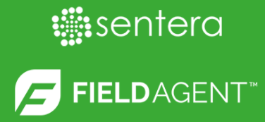

Appendix 1 - Price Point Comparison
Similar Precision agriculture platform in Australia
 | Subscription: $ 327/mo AUD (12-month) (same as $3920/yr) $ 399/mo AUD (1-month)
 | $1200 USD for 1-year unlimited use and users $1558/yr, $130/mo AUD
 | Basic： $284/mo AUD (6-month) $209/mo AUD (12-month) | Pro： $550/mo AUD (6-month) $425/mo AUD (12-month)
Notes:
Rise Above, Sentera Phantom 4 Pro NDVI Camera Upgrade Kit, https://www.riseabove.com.au/sentera-phantom-4-pro-ndvi-camera-upgrade
Rise Above - Slantview Analytics for Slantrange 3P
https://www.riseabove.com.au/slantview-analytics-for-slantrange-3p
Sentera FieldAgent Analytics Toolset Expands to Include Tassel Counts,
https://sentera.com/sentera-fieldagent-analytics-toolset-expands-to-include-tassel-counts/#:~:text=Availability%20and%20Pricing,or%20part%20of%20a%20field .

Slide 29
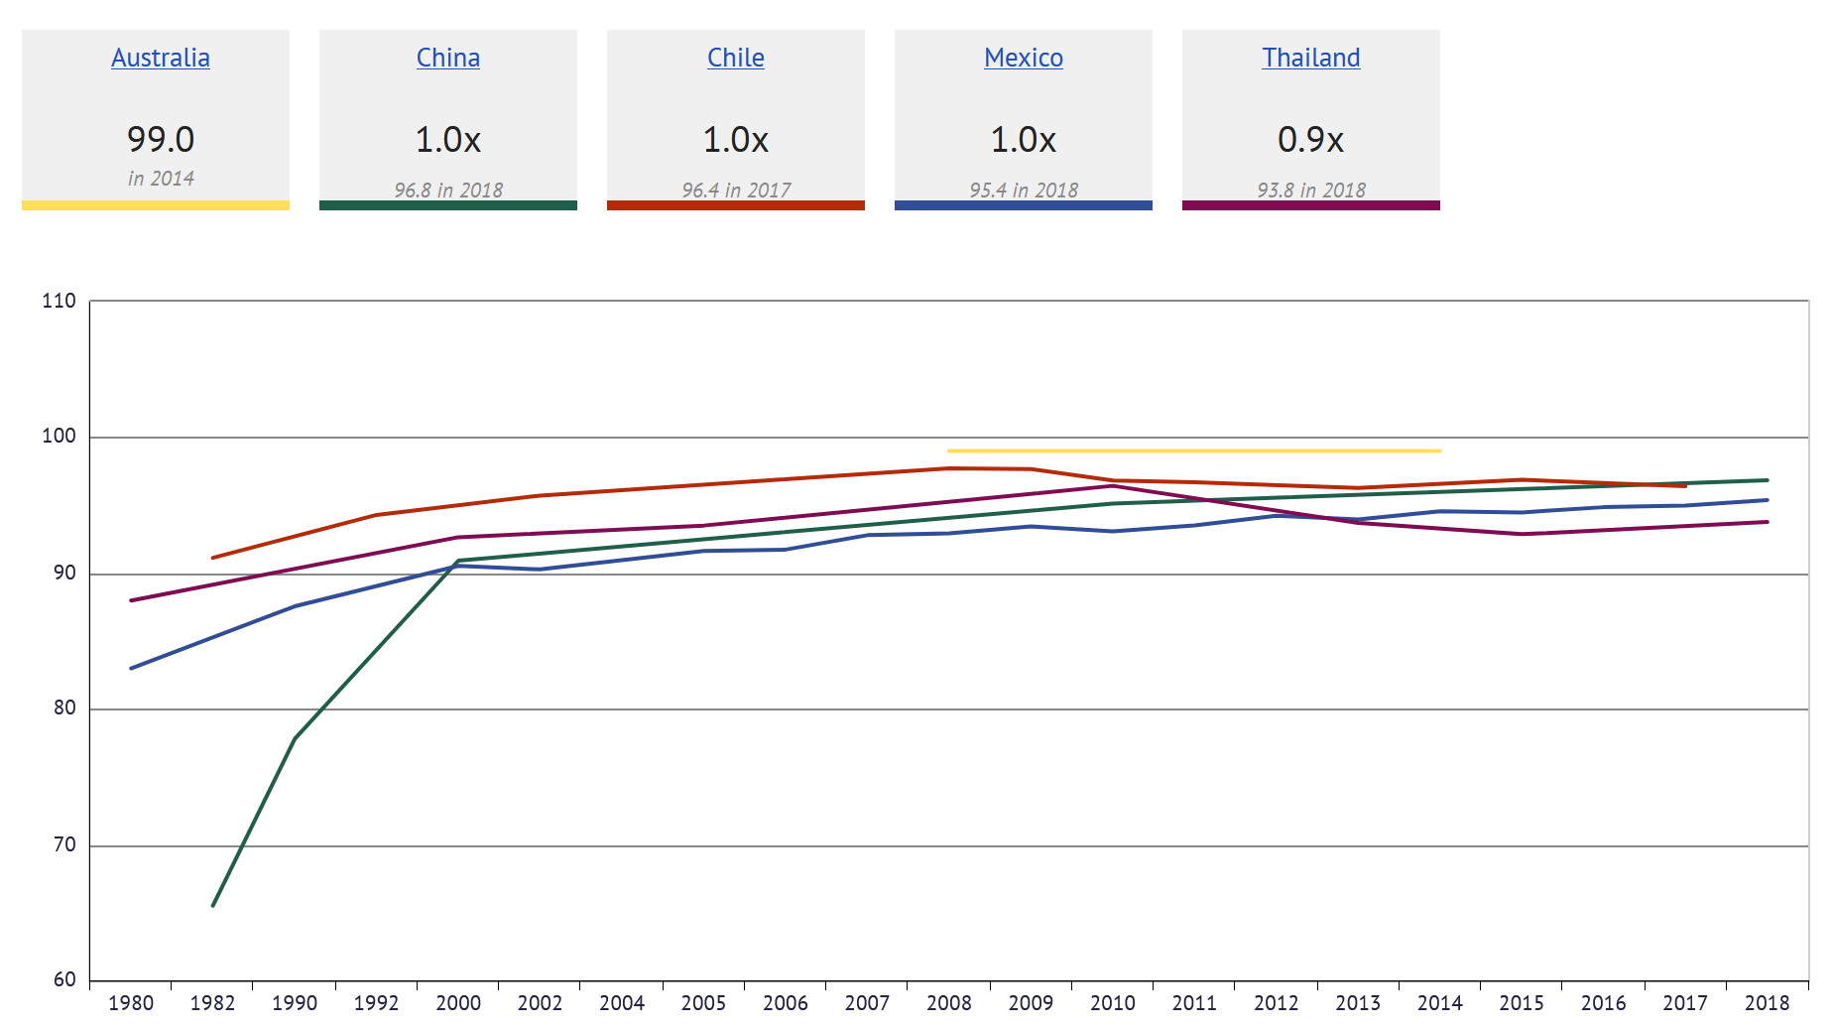
Appendix II - Adult (15+) literacy rate (%)
Notes:
https://knoema.com/atlas/Australia/topics/Education/Literacy/Adult-literacy-rate?compareTo=CN,CL,MX,TH

Slide 30
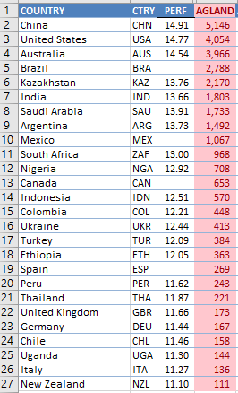
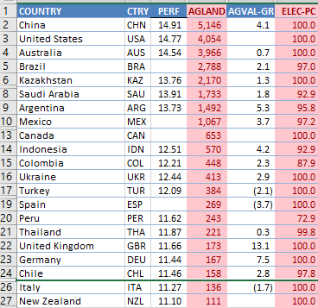
Appendix 3.1 - Selection Stepwise Result
Step 1 - Agriculture Land over 27
Step 2 - ELEC - PC >70

Slide 31
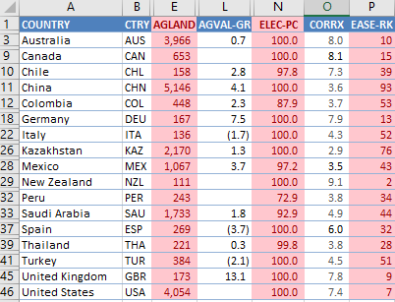
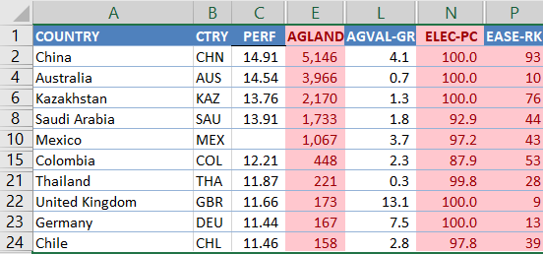
Appendix 3.2 - Selection Stepwise Result
Step 3 - Ease-PC < 100
Step 4 - AGVAL-GR >0

Slide 32
Bibliography
Impact of a vegan agricultural system on land use, https://www.veganaustralia.org.au/impact_of_a_vegan_agricultural_system_on_land_use
Niche and specialty crops are becoming more prevalent as croppers seeks to diversify,
https://www.farmonline.com.au/story/5048348/seven-crops-probably-not-in-your-rotation/
International Student - Map and Climate,
https://www.internationalstudent.com/study_australia/living_in_australia/map-climate/
Crop and climate suitability for irrigated agriculture in the Midlands area of Western Australia,
https://www.agric.wa.gov.au/sites/gateway/files/Crop%20and%20climate%20suitability%20for%20the%20Midlands%20area%20of%20Western%20Australia%20-%20RMTR%20405%20%28PDF%204.6MB%29.pdf
Budget Overview ,https://budget.gov.au/2020-21/content/overview.htm
Drone Rules, https://www.casa.gov.au/knowyourdrone/drone-rules
SUMMARY OF SMALL UNMANNED AIRCRAFT RULE (PART 107), https://www.faa.gov/uas/media/Part_107_Summary.pdf
Australia-United States FTA,
https://www.dfat.gov.au/trade/agreements/in-force/ausfta/Pages/australia-united-states-fta

Slide 33
Rise Above, Pix4Dfields - Drone Mapping Software for Precision Agriculture,
https://www.riseabove.com.au/pix4d-ag-drone-mapping-software-for-precision-agri
Rise Above, Sentera Phantom 4 Pro NDVI Camera Upgrade Kit https://www.riseabove.com.au/sentera-phantom-4-pro-ndvi-camera-upgrade
Rise Above - Slantview Analytics for Slantrange 3P
https://www.riseabove.com.au/slantview-analytics-for-slantrange-3p
Sentera FieldAgent Analytics Toolset Expands to Include Tassel Counts
https://sentera.com/sentera-fieldagent-analytics-toolset-expands-to-include-tassel-counts/#:~:text=Availability%20and%20Pricing,or%20part%20of%20a%20field .
Quote result for FCL shipping cost:
https://www.icontainers.com/quotes/FCL/USLAX/PORT/US/AUSYD/PORT/AU/
Australian Border Force:
https://www.abf.gov.au/importing-exporting-and-manufacturing/importing/cost-of-importing-goods
Information and communication technology use in Australian agriculture:
https://www.agriculture.gov.au/abares/research-topics/productivity/productivity-publications/ict-use-summary#download

Slide 34
Ranking of the average internet connection speed by country 2020
https://www-statista-com.proxygw.wrlc.org/forecasts/1147038/internet-connection-speed-by-country
Market Size
http://www.consortiumland.com/investors/variations-in-farm-size-across-the-australian-wheatbelt/
Precision Technology in Australia
https://www.agriculture.purdue.edu/SSMC/newsletters/March03_GlimpseofPrecisionAgricultureAustralia_gregedit1.htm#:~:text=The%20most%20surprising%20aspect%20of,the%20ends%20of%20the%20field.
https://www.sciencedirect.com/science/article/abs/pii/S037842900700113X
https://www.researchgate.net/publication/262706376_Precision_agriculture_in_Australia_present_status_and_recent_developments
Australia - Adult (15+) literacy rate (%)
https://knoema.com/atlas/Australia/topics/Education/Literacy/Adult-literacy-rate?compareTo=CN,CL,MX,TH
$4.5 billion NBN investment to bring ultra-fast broadband to millions of families and businesses and create 25,000 jobs
https://minister.infrastructure.gov.au/fletcher/media-release/45-billion-nbn-investment-bring-ultra-fast-broadband-millions-families-and-businesses-and-create-25000-jobs
Spacely, https://www.spacely.com.au/grenfell-street/private-office-space12292

